Slide 1




Gandhinagar
Machine Learning
The Past, Present and Future of AI
Charmi Chokshi, Ahmedabad University
@charmichokshi

Slide 2
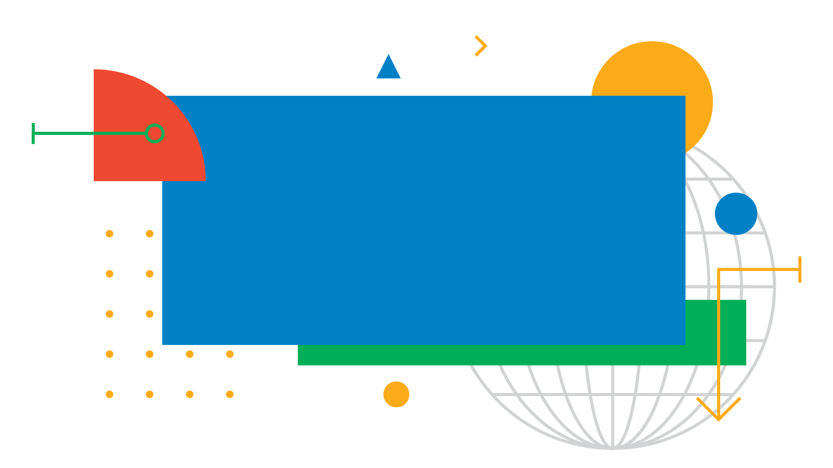
“AI is one of the most important things humanity is working on. It is more profound than, I dunno, electricity or fire”
Sundar Pichai

Slide 3
Session Outline
1
2
3
4
What is Machine Learning (ML)?
How is ML different from traditional programming?
What is the difference between ML, DL, and AI?
The history of Artificial Intelligence
Under the hood: ML with Pizza
Introduction to Machine Learning APIs
Gandhinagar

Slide 4

Gandhinagar
Let’s try some
human-powered image detection

Slide 5

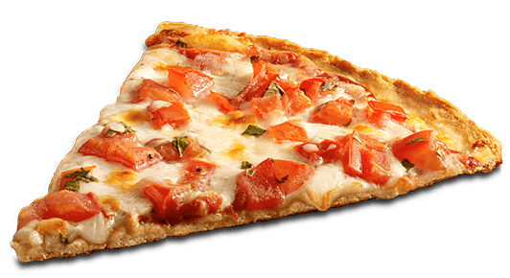
How would we do this without ML?
Gandhinagar

Slide 6
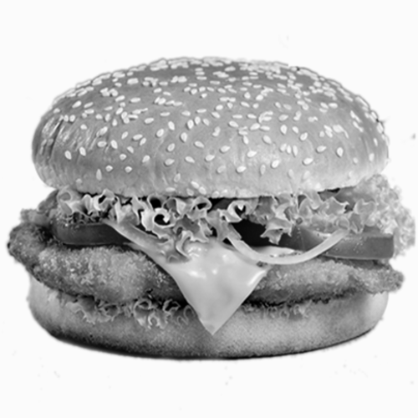
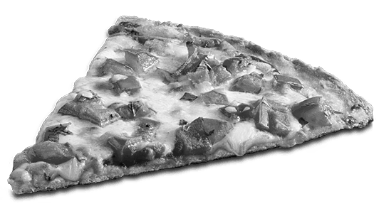
How would we do this without ML?
Gandhinagar

Slide 7

How would we do this without ML?
Gandhinagar

Slide 8
Traditional Programming vs ML
Traditional Programming
Machine Learning
System learns patterns from data Improvements may also come from additional data
Explicit instructions from programmer Improvements come from better algorithms
Gandhinagar
Notes:
Reduces Programming Time
Customize and Scale Products
Complete Seemingly ‘unprogrammable’ tasks

Slide 9





What is Machine Learning?
Collect Data
Predict
Focus on User
Define Objective
Train and Test Model
System learns patterns from data
Gandhinagar

Slide 10


Slide 11
AI vs ML vs DL
A subset of ML exposing multilayered neural networks to vast amount of data
Machine
Learning
Artificial Intelligence
Deep
Learning
Any Technique that enables computers to mimic human intelligence & behaviour
A subset of AI that includes statistical techniques to solve the tasks using experience

Slide 12
Gandhinagar
Let’s travel back in time...

Slide 13
1943
A Logical Calculus of the Ideas Immanent in Nervous Activity
Warren S. McCulloch and Walter H. Pitts published ground- breaking paper. It quickly became the foundational work in the study of artificial neural networks.
Gandhinagar
Notes:
& has many applications in artificial intelligence research.

Slide 14
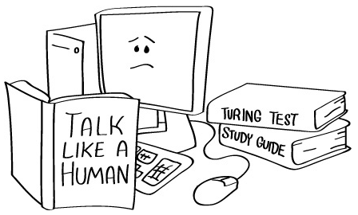
1950
Turing Test
Computer scientist Alan Turing proposes a test for machine intelligence. If a machine can trick humans into thinking it is human, then it has intelligence.
Gandhinagar

Slide 15
1956
A.I. Born
Term ‘Artificial Intelligence’ is coined by computer scientist,
John McCarthy to describe “the science and engineering of making intelligent machines.”
After that in 1958, Rosenblatt proposed a simple neuron that is used to classify its input onto 1 or 2 categories.
Gandhinagar

Slide 16
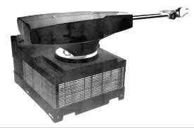
1962
Unimation
First industrial robot company, Unimation founded. The robot goes to work at GM replacing humans on the assembly line.
Gandhinagar

Slide 17
1964-66
Eliza
It is an early natural language processing interactive computer program that carries a dialogue in English on any topic. Pionarring chatbot developed by Joseph Weizenbaum at MIT holds conversations with humans.
Gandhinagar

Slide 18
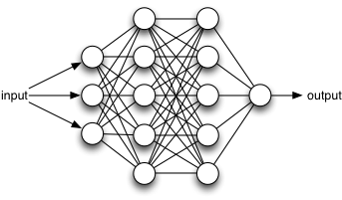
1974
Backpropagation
Paul J. Werbos, a scientist best known for his Harvard University Ph.D. thesis, which first described the process of training artificial neural networks through backpropagation of errors.
Gandhinagar

Slide 19
1997
Deep Blue
A chess playing computer from IBM defeats world chess champion Garry Kasparov.
Several Machine Learning algorithms namely, Decision Tree, Random Forest, Support Vector Machine, RNN, LSTM have been introduced in late 20th century.
Gradient based technique applied to Document Recognition by Yann LeCun, Lion Bottuo, Yoshua Bengio, and Patrick Haffner
Gandhinagar
Notes:
Hello world of ML, hand written digit recognition

Slide 20
2011
Siri, Watson
Apple integrates Siri, an intelligent virtual assistant with a voice interface, into the iphone 4S.
IBM’s question answering computer Watson wins first place on popular $1M prize television quiz show Jeopardy.
Gandhinagar

Slide 21
2014
Eugene, Alexa
Eugene Goostman, a chatbot passes the Turing Test with a third of judges believing Eugene a human.
Amazon launches Alexa, an intelligent virtual assistant with a voice interface that completes shopping.
Proposal of a new framework, Generative Adversarial Networks by Ian Goodfellow & team
Gandhinagar

Slide 22
2017
AlphaGo, Google Lens, Actions on Google...
Google’s AI based AlphaGo beats world champion Ke Jie in the complex board game of Go, notable for its vast number (2¹⁷⁰) of possible positions.
Data become the new oil
Google Lens which can understand what you are looking at
Cloud ML, a suite of ML products that enables developers with limited machine learning expertise to train high-quality models
Actions of Google
Launch of Gmail’s auto-reply
Gandhinagar

Slide 23
Gandhinagar
Under the hood:
ML with Pizza

Slide 24



Learning Objective
By the end of the session, you will have run a machine learning experiment to classify foods as pizza or not pizza
Gandhinagar
Not-Pizza
Pizza

Slide 25
Pair Work: Run an ML Experiment
Find a partner
Go to https://sliceofml.withgoogle.com/
Click "Let’s do this”
Gandhinagar

Slide 26
Run an ML Experiment
Steps to follow
Set Goal
Split Data
Train Model
Test Model
Results
Gandhinagar

Slide 27
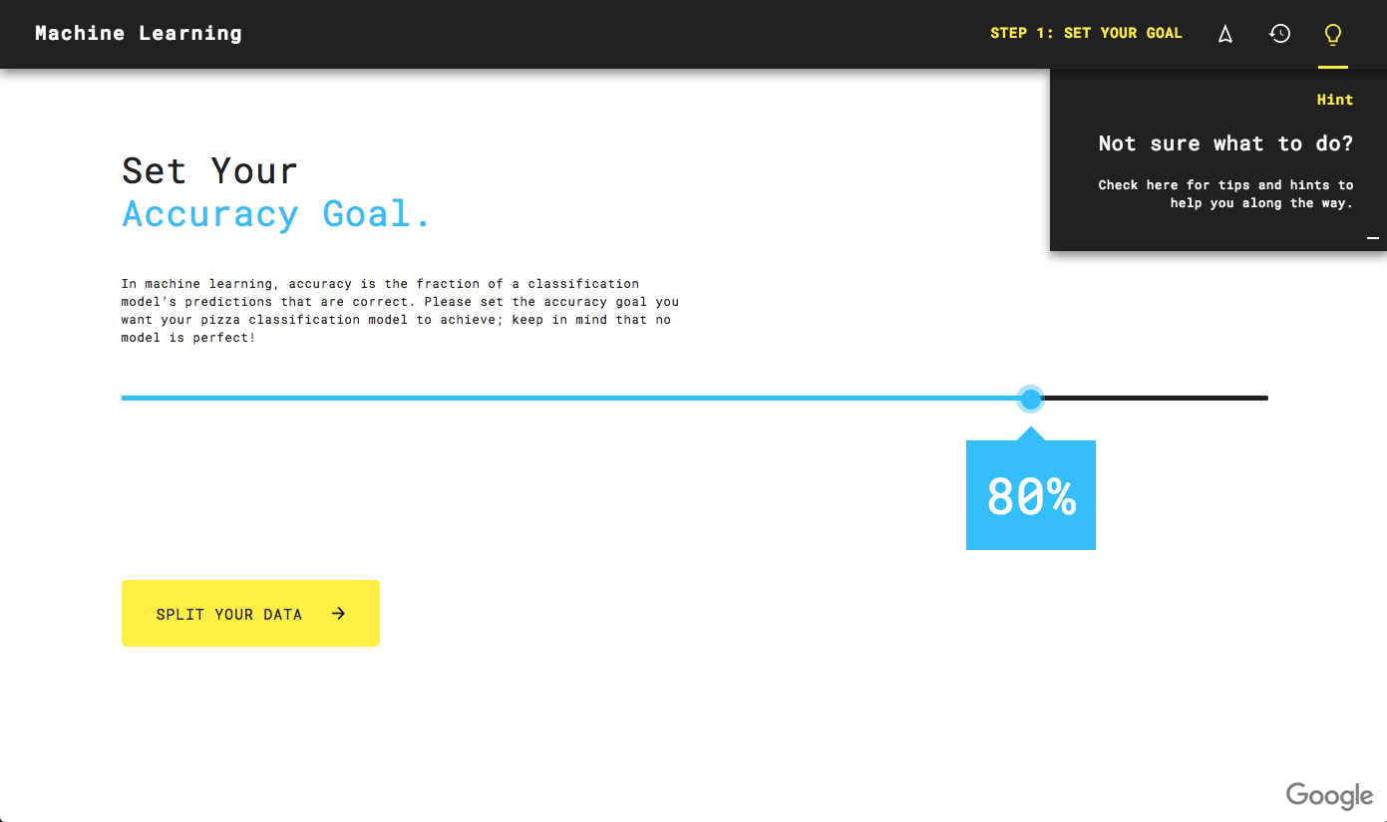
Set an Accuracy Goal
Gandhinagar

Slide 28
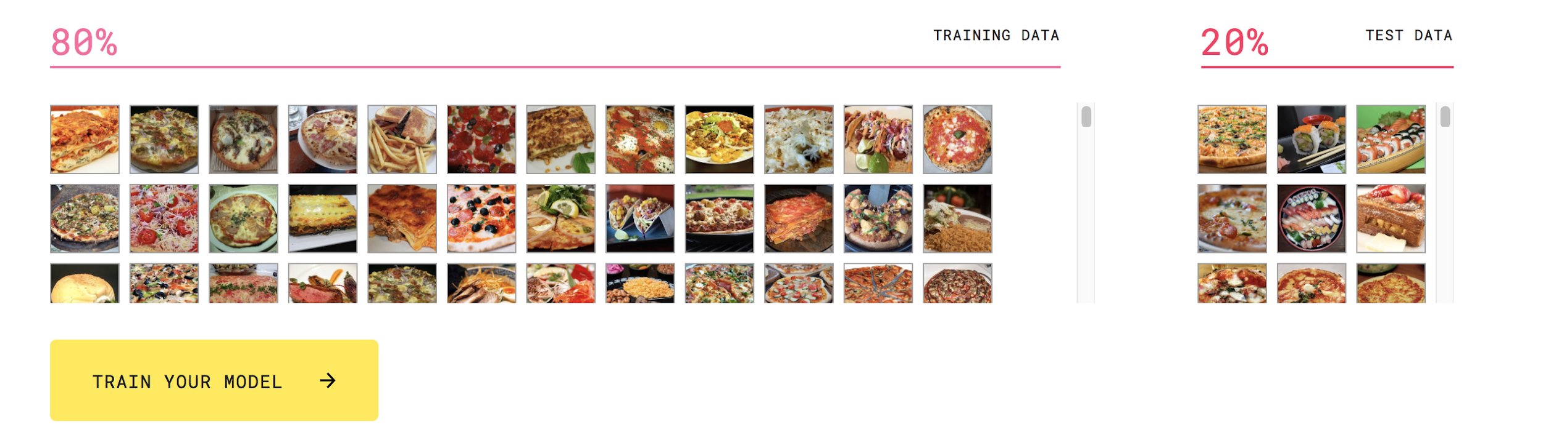
Divide data into train and test
Gandhinagar

Slide 29
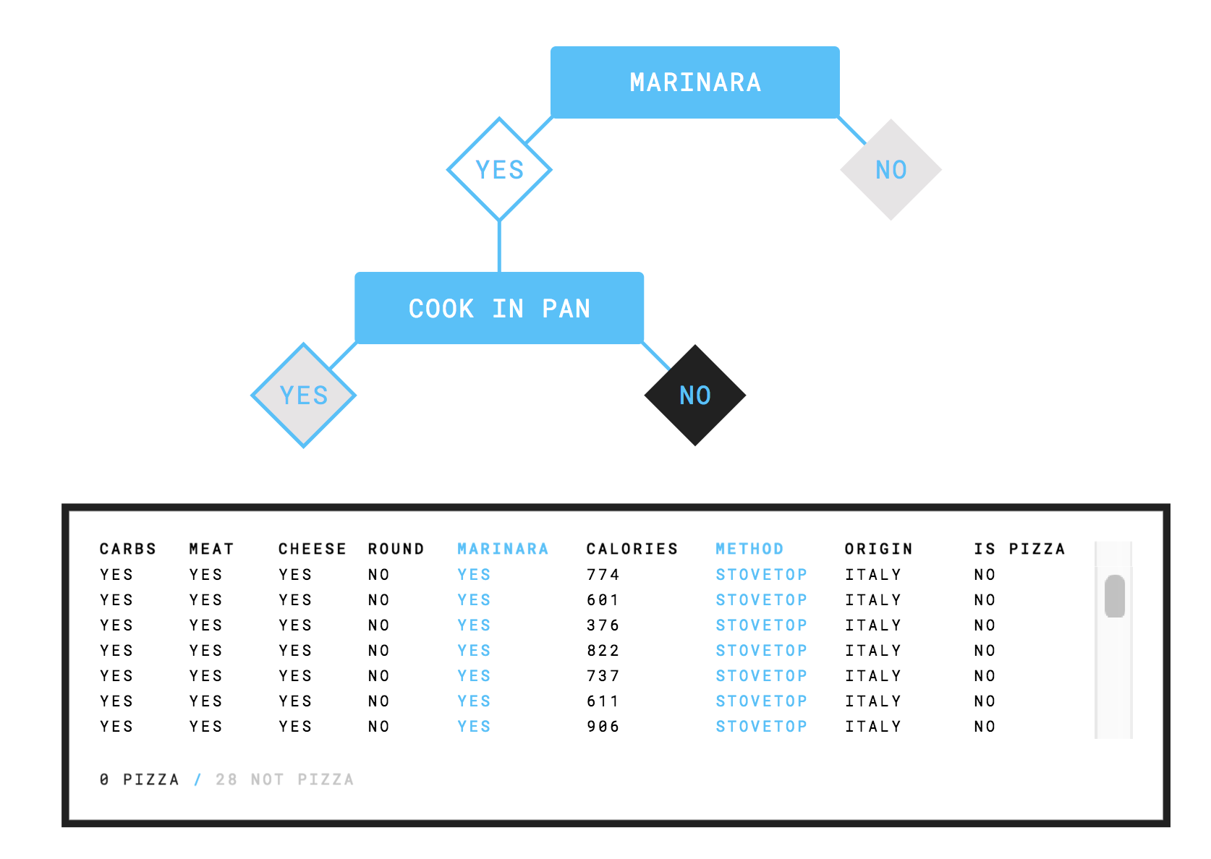
How does the Decision Tree work?
Gandhinagar

Slide 30
Refine the experiment to get your model's training and testing accuracy to be 90% or more
1
2
3
4
Set
Goal
Split
Data
Train
Model
Test
Model
Gandhinagar

Slide 31

Tweak the model: Run More Experiments
1
2
3
4
5
Set
Goal
Split
Data
Train
Model
Test
Model
Results
Gandhinagar

Slide 32
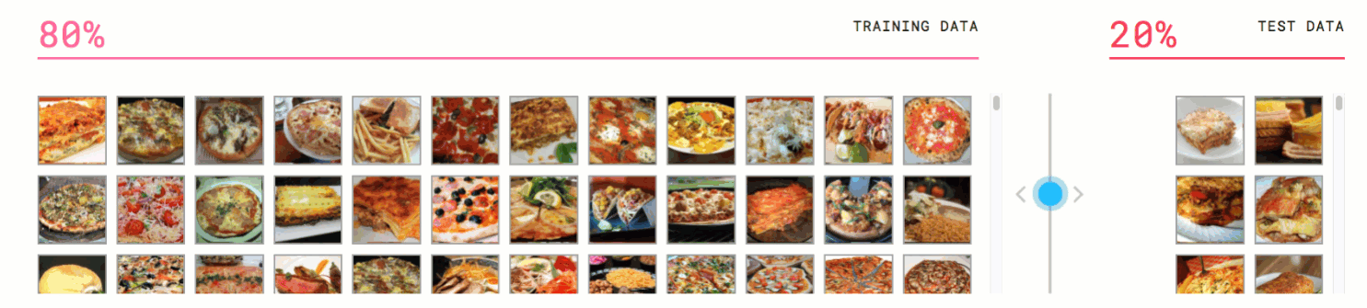
Tweak the model: Run More Experiments
1
2
3
4
5
Set
Goal
Split
Data
Train
Model
Test
Model
Results
Gandhinagar

Slide 33
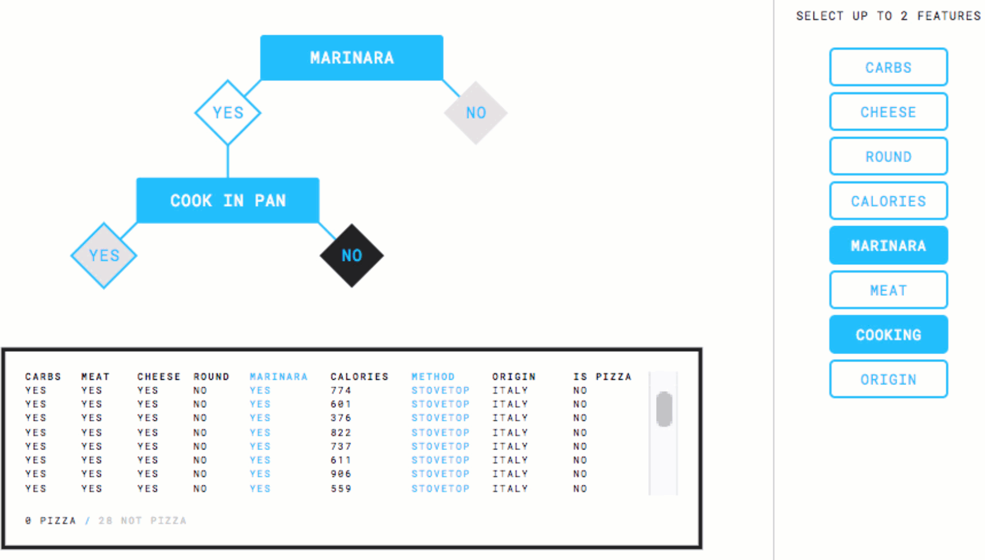
Tweak the model: Run More Experiments
1
2
3
4
5
Set
Goal
Split
Data
Train
Model
Test
Model
Results
Gandhinagar

Slide 34
Gandhinagar
What about photos of everything?

Slide 35
Gandhinagar
What about other types
of unstructured data?
Video, audio, text...

Slide 36
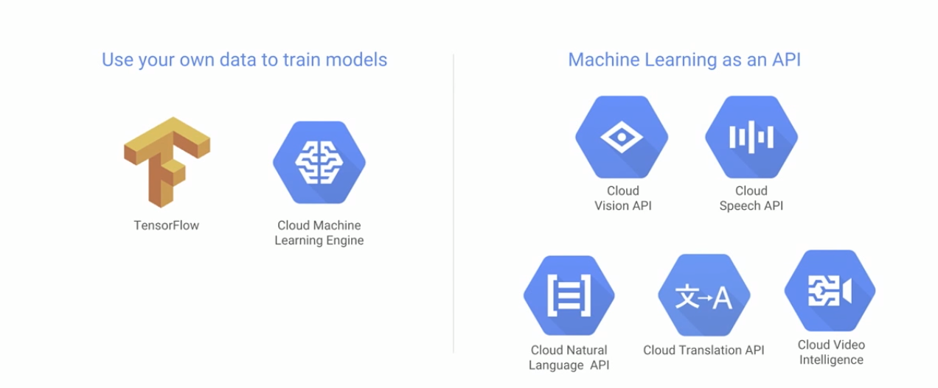
Two ways Google can help us benefit from ML
Gandhinagar

Slide 37
Gandhinagar
What is the Google Vision API?

Slide 38
Vision API
Complex image detection with a simple REST request
The Cloud Vision API gives you contextual data on your images by leveraging Google’s vast network of machine learning expertise with a single API request. It uses a pre-trained model trained on a large dataset of images, similar to the models used to power Google Photos.
Gandhinagar

Slide 39
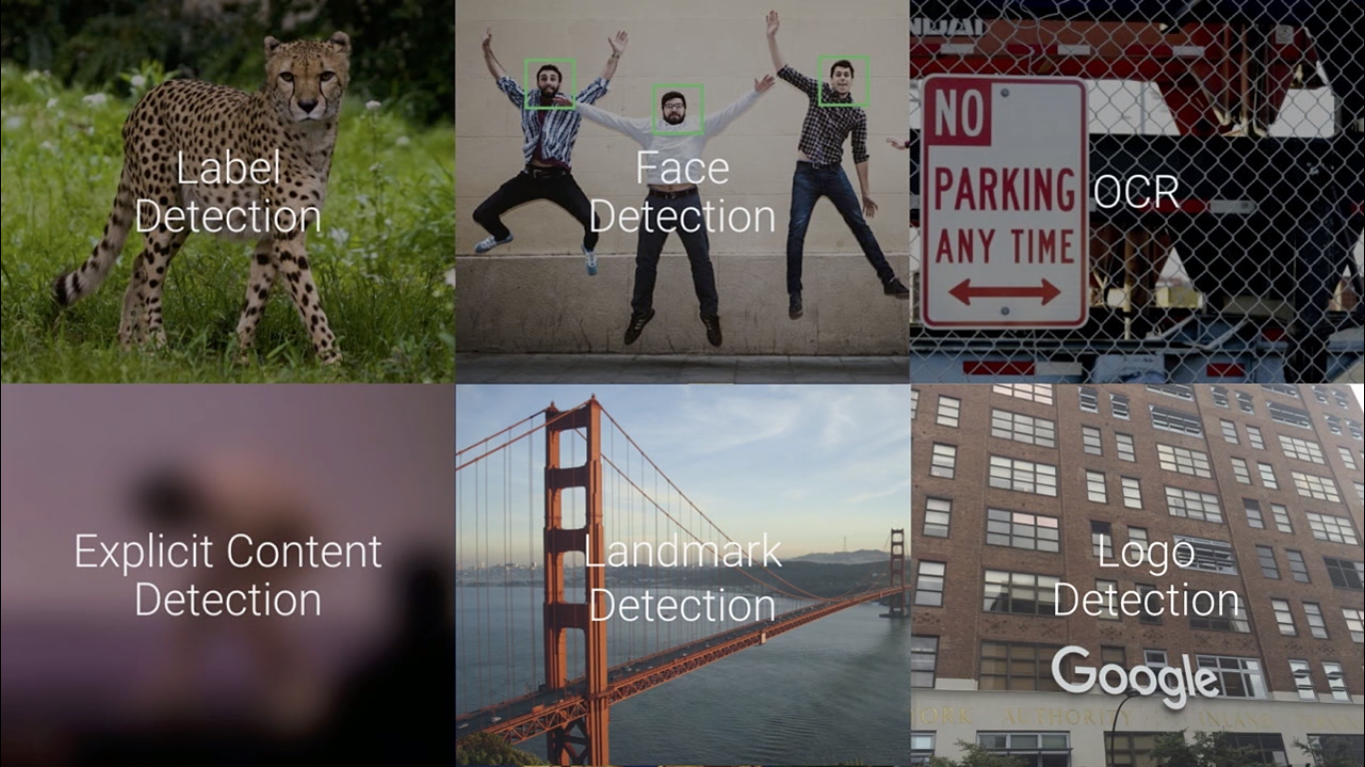

Slide 40

Vision API:
cloud.google.com/vision/
Gandhinagar
Notes:
https://medium.com/@srobtweets/exploring-the-cloud-vision-api-1af9bcf080b8
https://www.youtube.com/watch?v=ETeeSYMGZn0&feature=youtu.be&t=3m50s

Slide 41
"landmarkAnnotations": [ { "mid": "/m/04x4w7", "description": "25 de Abril Bridge", "score": 0.87690926, "boundingPoly": { "vertices": [ { "x": 87, "y": 138 }, ... ] }, "locations": [ { "latLng": { "latitude": 38.693791, "longitude": -9.177360534667969 } } ] } ]

Slide 42
"webEntities": [ { "entityId": "/m/04x4w7", "description": "25 de Abril Bridge" }, { "entityId": "/m/0gnqtl", "description": "Christ the King" }, { "entityId": "/m/02snjn", "description": "University of Lisbon" }, ... ]

Slide 43
"fullMatchingImages": [
{
"url": "http://travelanddance.be/onewebmedia/55%20lisbon.jpg"
},
...
],
"visuallySimilarImages": [
{
"url": "http://2.bp.blogspot.com/-3QFcsa0kJFE/TjLxF5MgbHI/AAAAAAAADZE/mp6gmJbmZDo/s400/puente+25.jpg"
},
...
],
"pagesWithMatchingImages": [
{
"url": "https://www.youtube.com/watch?v=OJirc431z2Y"
},
...
]

Slide 44
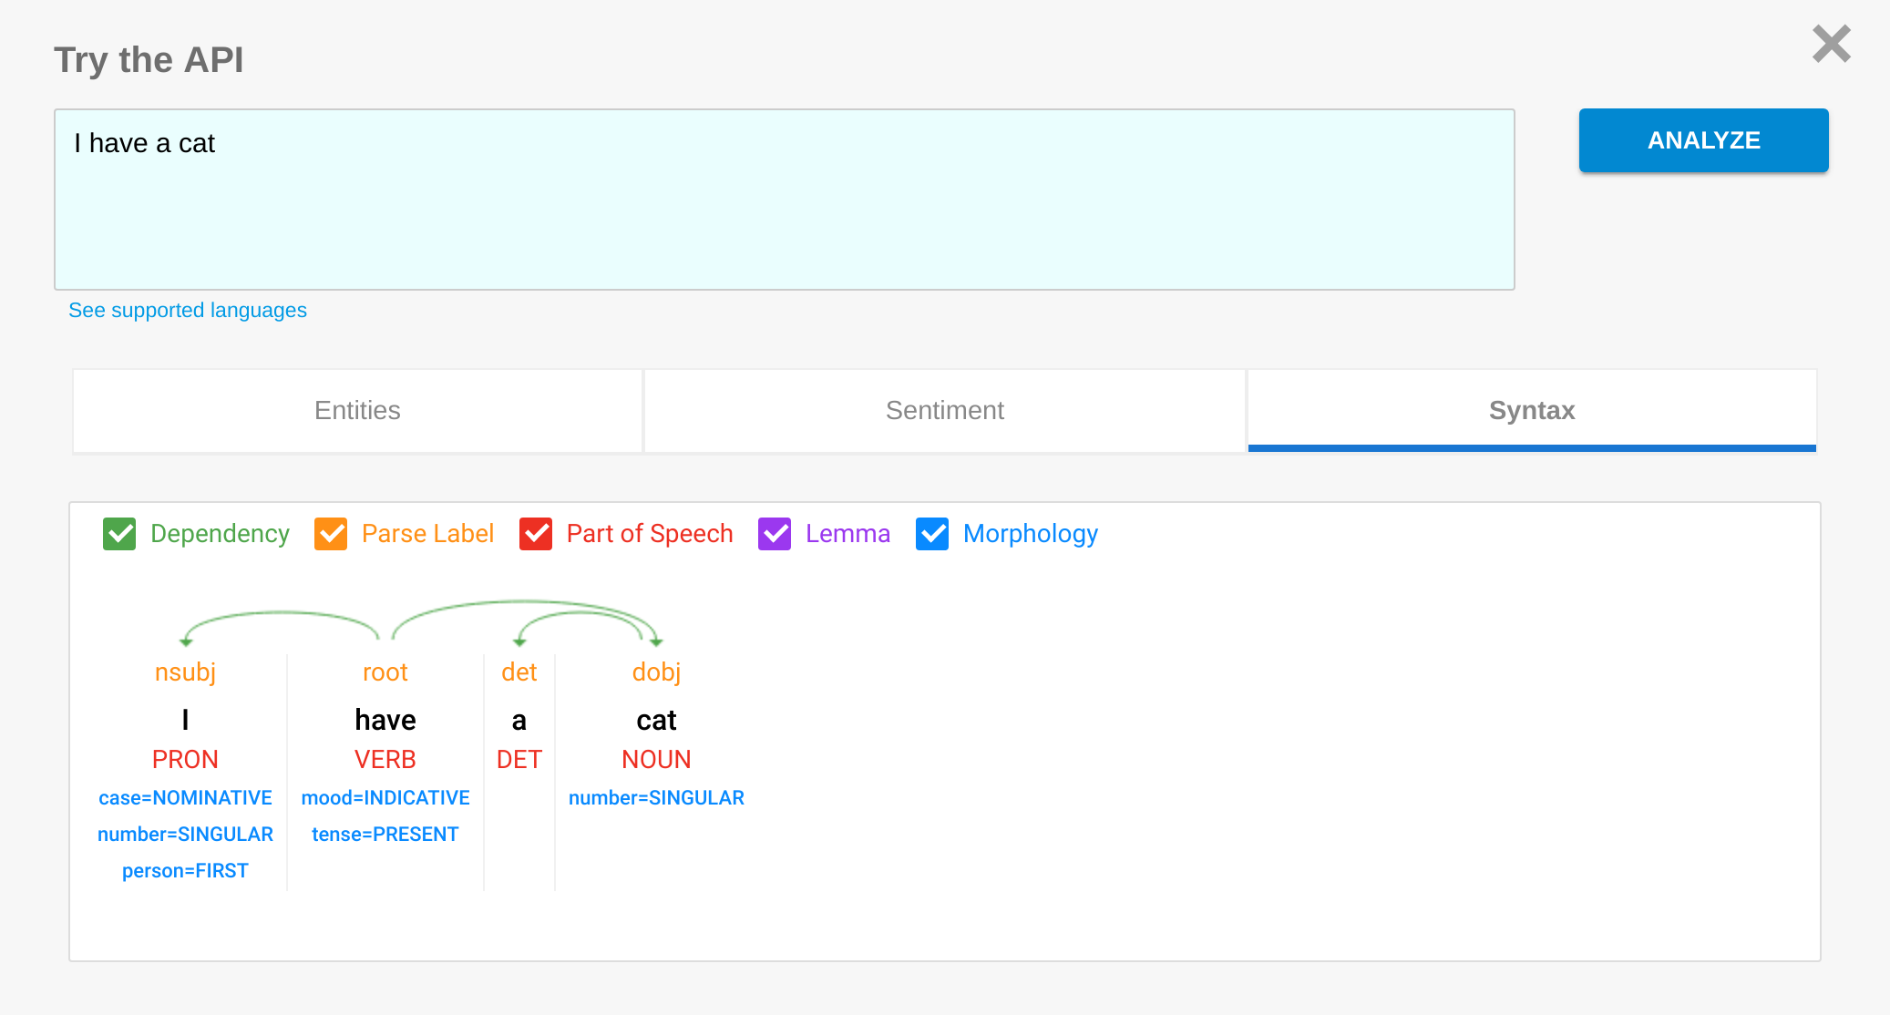
Natural Language Understanding API: cloud.google.com/natural-language/
Gandhinagar

Slide 45
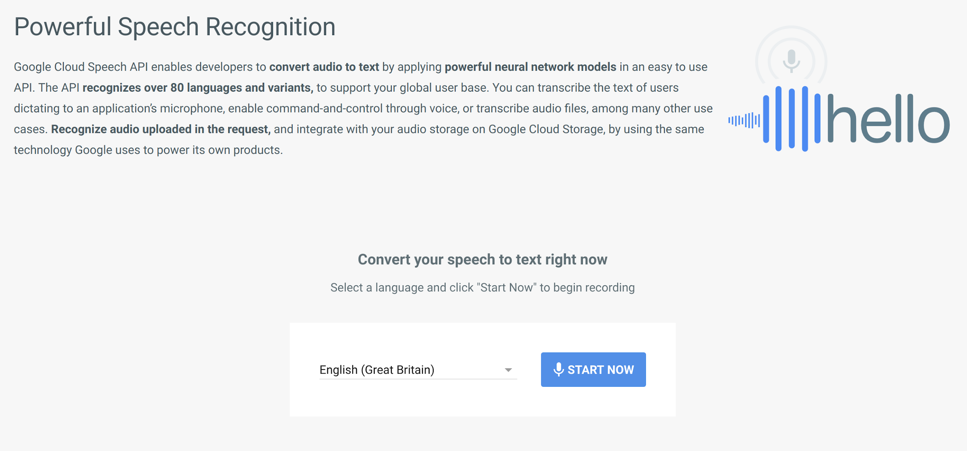
Speech API:
cloud.google.com/speech/
Gandhinagar

Slide 46
This is just a Start!
We will have an AI Doctor
Our Boss will be a Bot
There will be Robot Criminals
Robots will beat us at Sports
News will not be written by Humans, Poems too!
We will live as Chatbots after we Die
The day is not so far when there will be all Robot Speakers in DevFest Gandhinagar !?
Gandhinagar
Notes:
https://nulltx.com/10-ways-ai-will-affect-our-lives-in-2050-according-to-leading-australian-ai-scientist/
http://www.alphr.com/artificial-intelligence/1002792/what-is-ai-ten-things-you-need-to-know-about-the-future-of

Slide 47
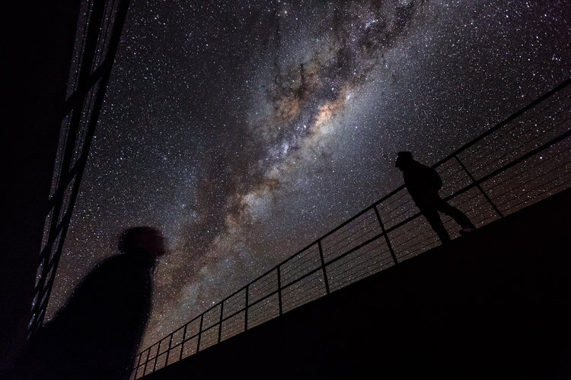
AI could be the reason why we've never met Aliens
Elon Musk described AI as an “existential threat” to humanity, meaning that it could
erase mankind from the universe entirely

Slide 48
Gandhinagar
Q&A
Comments
Suggestions

Slide 49


Gandhinagar
Thank you!
Charmi Chokshi
charmichokshi

